Slide 1
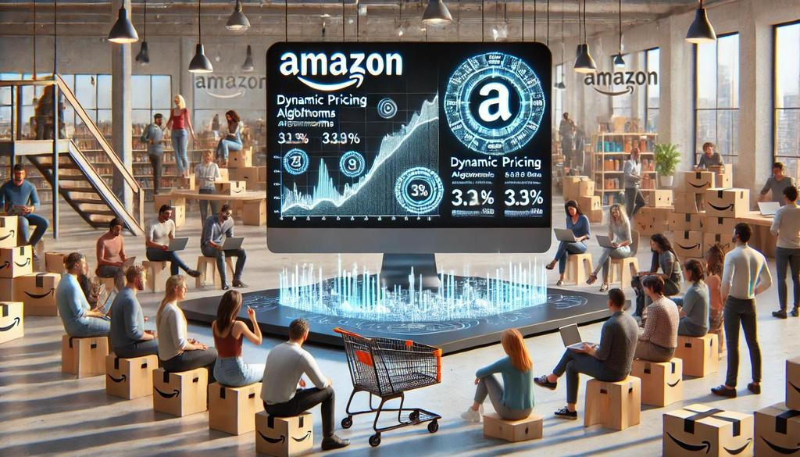

SQL Capstone Project - Amazon Sales Data:
This capstone project aims to analyze Amazon's sales data to understand the factors influencing sales across different branches. The dataset includes sales transactions from Mandalay, Yangon, and Naypyitaw, with 17 columns and 1000 rows. The project will cover product, sales, and customer analysis to provide actionable insights.
by Abhilash Jadhav
Cohort – DS47D Student ID : 10084

Slide 2
INDEX:
Overview of the project.
Technical Stacks.
Approach Used.
Data Insights.
Business Problem.
Key Takeaways.
Recommendations.

Slide 3




TECHNICAL STACKS:

Slide 4

APPROACH USED:
Data Wrangling:
Inspection:
Data inspection is crucial to detect NULL and missing values. This ensures data quality and reliability for subsequent analysis.
Database Building
Building a database involves creating tables and inserting data. This step organizes the data for efficient querying and analysis.
NULL Value Handling
The database is designed to filter out NULL values by setting NOT NULL for each field during table creation, ensuring data integrity.

Slide 5

FEATURE ENGINEERING:
Time of Day
Add a 'timeofday' column to categorize sales into Morning, Afternoon, and Evening. This helps identify peak sales periods.
Day Name
Create a 'dayname' column to extract the day of the week for each transaction. This reveals the busiest days for each branch.
Month Name
Include a 'monthname' column to extract the month of the year for each transaction. This identifies months with the highest sales and profit.

Slide 6
DATA INSIGHTS:
Product Analysis:
HIGHEST REVENUE PRODUCT LINE: Food and Beverages Generating Highest Revenue.
LOWEST REVENUE PRODUCT LINE: Health and beauty Generating Lowest Revenue.
HIGHEST SALES PRODUCT LINE: Electronic Accessories.
LOWEST SALES PRODUCT LINE: Health and Beauty.

Slide 7
Sales Analysis:
MONTH WITH HIGHEST REVENUE: January has Generated Highest Revenue.
MONTH WITH LOWEST REVENUE: February has Generated Lowest Revenue.
CITY WITH HIGHEST REVENUE: Naypyitaw has Generated Highest Revenue.
CITY WITH LOWEST REVENUE: Mandalay has Generated Lowest Revenue.
PEAK SALES TIME OF DAY: Afternoon has recorded Highest Sales while Morning with Lowest Sales.
PEAK SALES DAY OF WEEK: Saturday has recorded Highest Sales.

Slide 8
3. Customer Analysis:
PREDOMINANT GENDER: Females contributed more to Revenue, although difference between
contribution is not much.
PREDOMINANT CUSTOMER TYPE: Member.
HIGHEST REVENUE GENDER: Female.
HIGHEST REVENUE CUSTOMER TYPE: Member.
MOST POPULAR PRODUCT LINE (MALE): Health and Beauty.
MOST POPULAR PRODUCT LINE (FEMALE): Fashion and Accessories.

Slide 9

Business Problem:
The Amazon company is facing significant challenge to gain insight from the sales data to understand the different factors that affect sales of the different branches.

Slide 10
Key Takeaways:
Product Trends: Food & Beverages dominates sales, while Home - Lifestyle &Electronics require improvement.
Customer Insights: Member customers and specific gender preferences shape purchasing behaviour.
Revenue Patterns: Naypyitaw generates the highest revenue, with Saturdays and Afternoon being peak periods.

Slide 11
Recommendations:
Health and Beauty products underperform across metrics and require a comprehensive plan to enhance the product line.
Leverage the high sales and revenue in January by offering diverse customer options and implementing effective, targeted strategies.
Prioritize new product launches or campaigns during the peak afternoon sales hours.
Develop a plan to increase memberships, as member customers contribute more, potentially due to incentives or offers. This can reduce Acquisition Cost and drive higher revenue.

Slide 12
THANK YOU.

